Slide 1
TAPAS and CHARM.
Ayan Paul
University of Notre Dame du Lac
Notre Dame IN
Antiproton Physics at the Intensity Frontier, FNAL, Batavia IL. 18th Nov. 2011.

Slide 2
Experiments Past.

Slide 3
Measurements of Charm
Dynamics was a
Challenge!

Slide 4

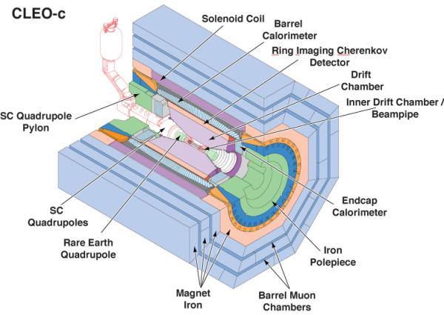
Dedicated to Charm.
Pioneering analysis of:
Lifetime of charm states.
Neutral charm meson mixing.
Semileptonic and hadronic decays.
CP violation
Rare and forbidden decays.
etc.

Slide 5
Experiments Present.

Slide 6
Charm is no longer
a Background!

Slide 7
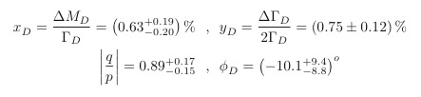

Charm
oscillation have been observed:
assuming no DIRECT CP violation:
but CP violation hasn’t been observed (?)
and many decay channels remain unmeasured
Note: Only quark in the up sector that can participate in oscillations

Slide 8

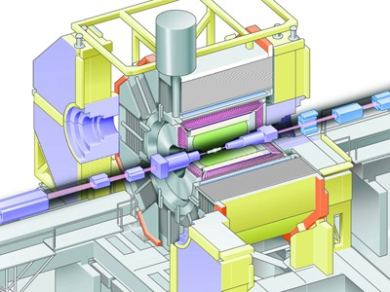


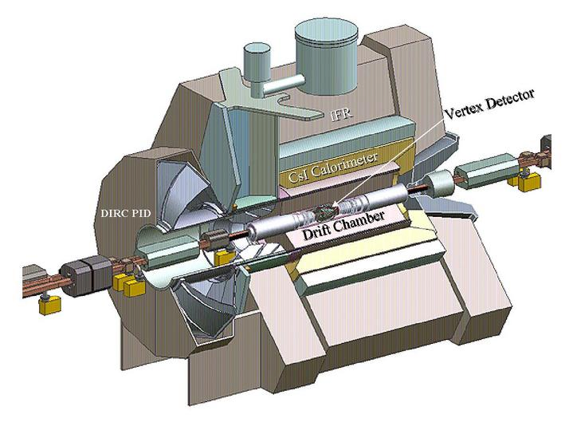

B Factories
Resonance production of B meson pairs.
Continuum production of Charm pairs.

Slide 9

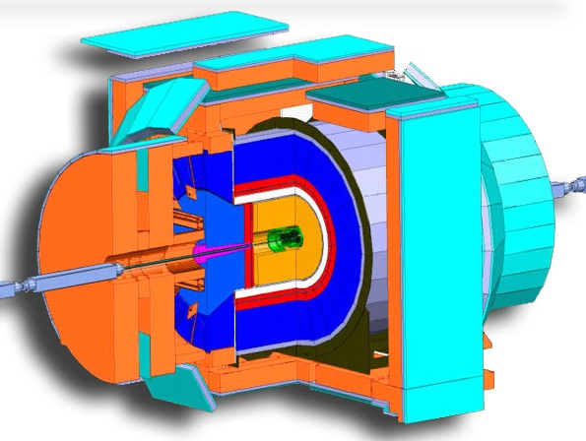

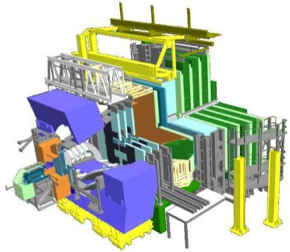
Hadron Colliders
Much larger production cross-sections.
Not as clean as e⁺e⁻ machines.
CDF has showed that flavour physics can be done in a hadronic environment.
LHCb has inherent production asymmetry that needs to be well understood through control samples.
Secondary charm benefits from good b-tagging.
Primary charm tagging is in its nascent stage.
Mesons produced at larger boosts.

Slide 10
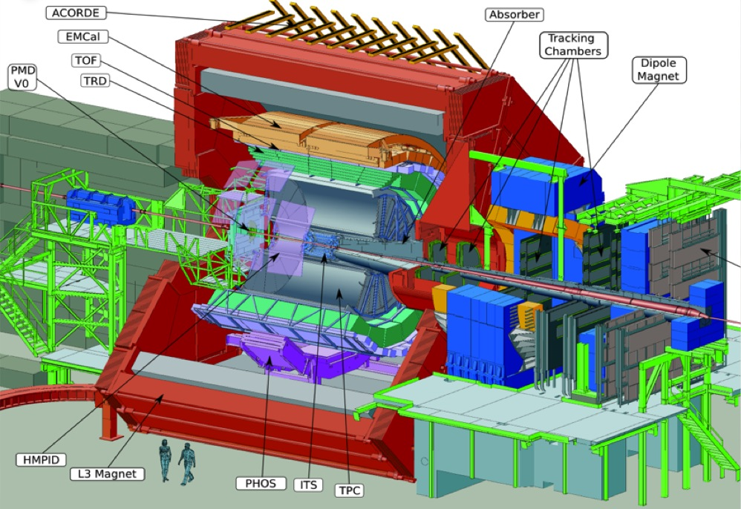
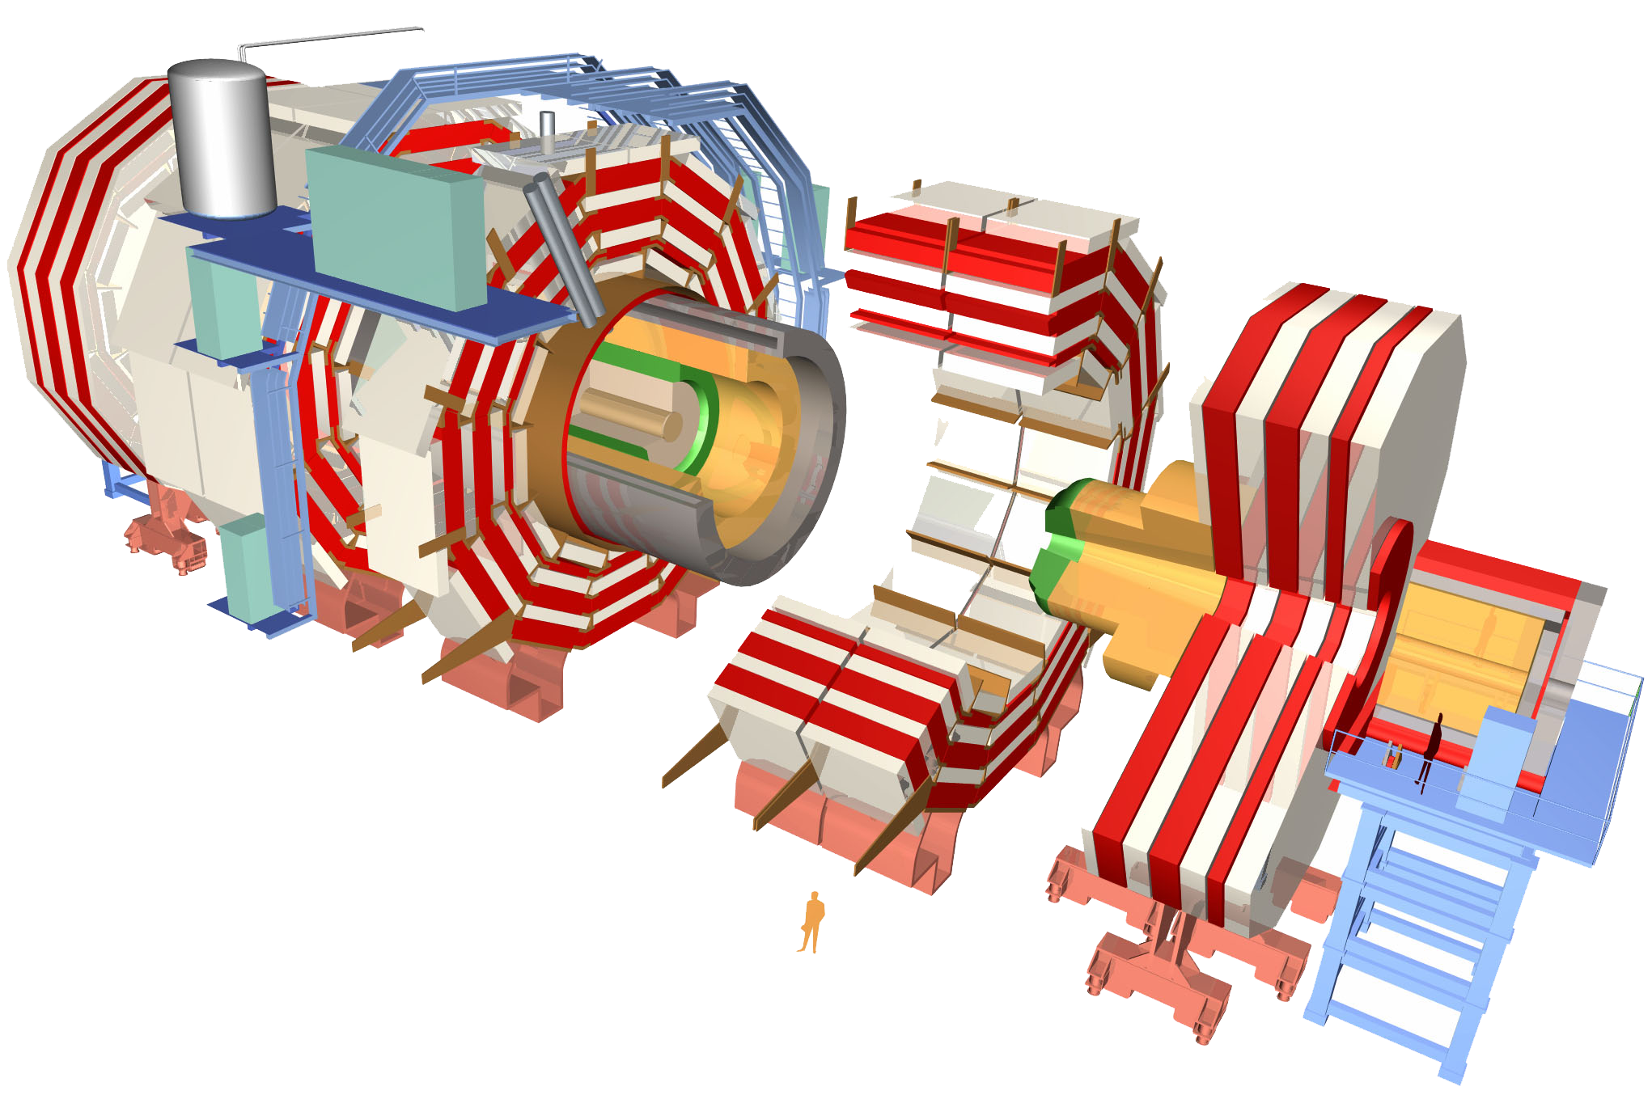
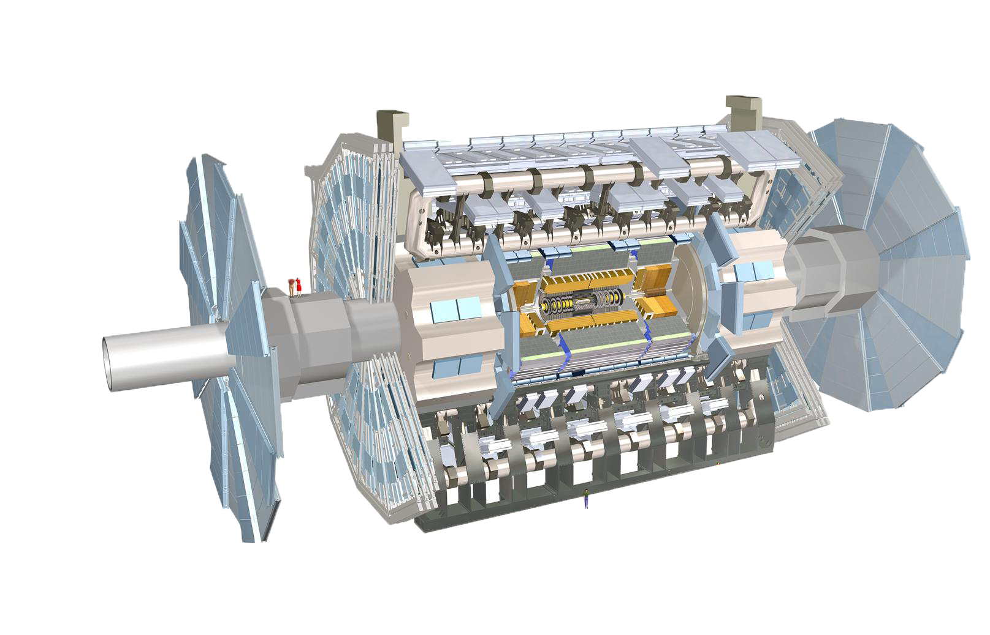
and some others that care…

Slide 11
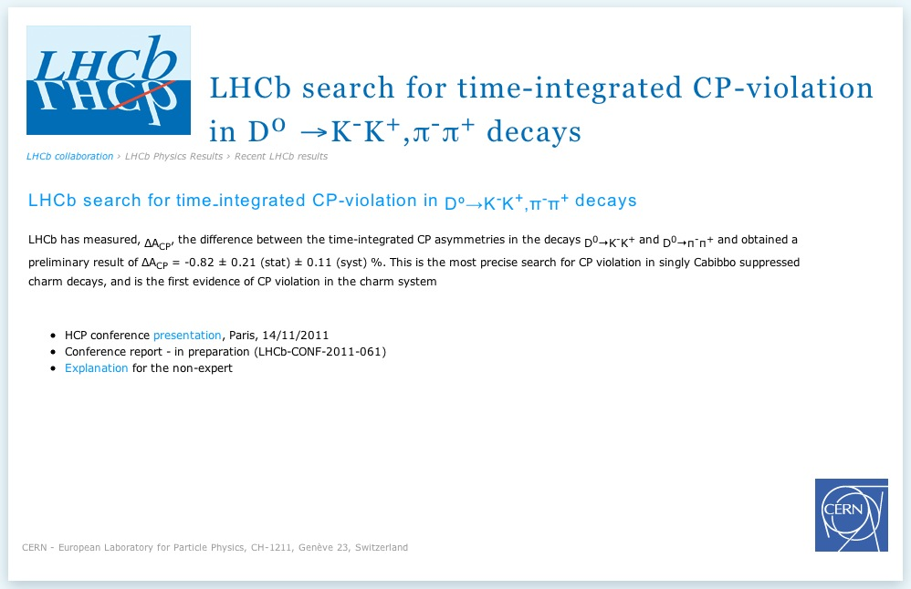

Slide 12
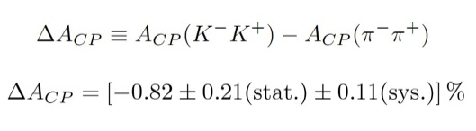
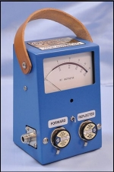
3.5σsignificance.
First Evidence of CP Violation in charm.
Note: Asymmetries have opposite signs for the two modes.
Disclaimer: This is a theory assumption!

Slide 13
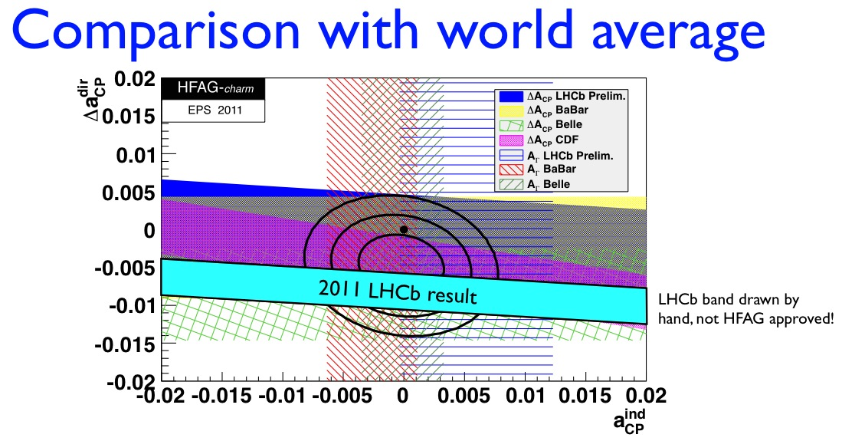
Is there anything wrong?
Indirect CP violation “should be” universal.( Careful about the interference!)
Possible “large” direct CP violation.
Plot and numbers from presentation by Mat Charles at LHCb WS.

Slide 14
Experiments Future.

Slide 15
a.k.a. Competition!

Slide 16

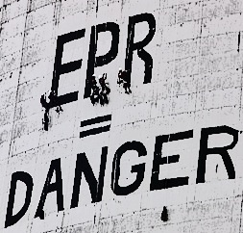
D Factories
The meson pair is produced in a C odd P wave.
EPR Correlations comes to the rescue.
CP violation implied by mere existence of certain final states.
Both direct and indirect CPV can be probed.

Slide 17
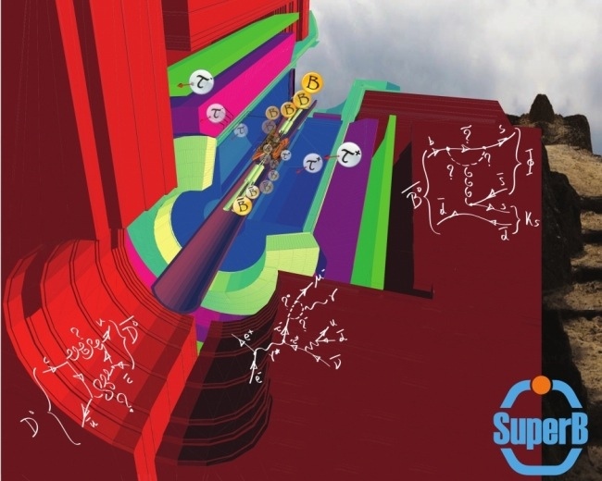
Super B Factory(ies)
Super B = Super D
D produced from B offer a cleaner analysis.
Not only low, but well understood backgrounds.
The D eigenstates are no longer correlated, a disadvantage.

Slide 18
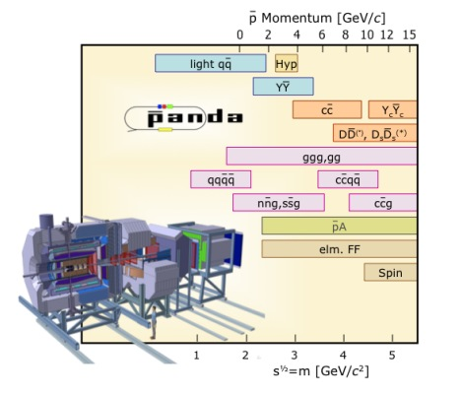
A FAIR PANDA
Nearly full solid angle coverage.
Very high angular resolution.
1.5 -15 GeV/c beam.
Shiny new detector.
Manpower.
Manpower.

Slide 19
The Theorists’ World.

Slide 20

Answers?
Can oscillations in charm be accommodated in the SM?
SM contribution to rare decays are tiny. Does ND have a good chance?
Can charm physics constrain models of New Dynamics?
How do direct and indirect CP violation compare against each other?
Why is CP violation predicted to be tiny in charm dynamics?

Slide 21
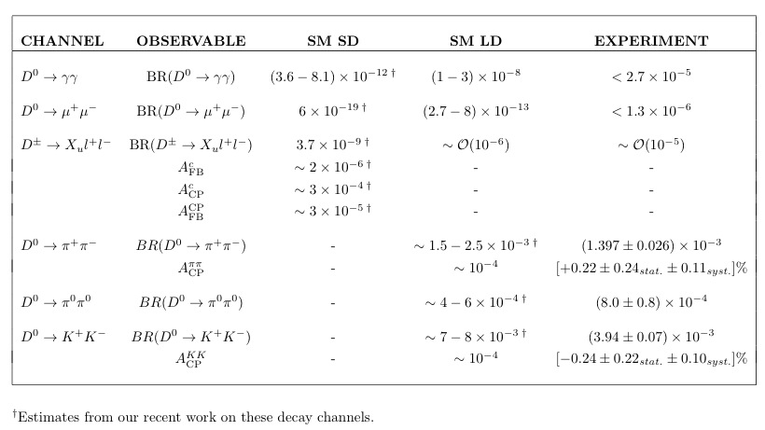
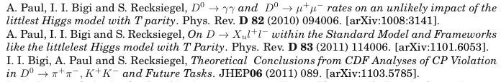
Charm Changing Neutral Currents

Slide 22
Defining LHT-like (or EGFS?)
A second sector of fermions that are an exact copy of the SM ones.
New forces that mediate interactions.
Mass mixing matrices that are constrained by a relationship between the one(s) connecting the new Up-type quarks with the SM down-type quarks to the one(s) connecting the new Down-type quarks with the SM up-type quarks
Possible large angles and phases in the mass mixing matrices.
Possible large hierarchies in the masses of the mirror fermions.
A symmetry, like T parity, segregating the New Physics sector from the SM sector, hence forbidding tree-level FCNC. The symmetry can be discrete or continuous.
Some that are LHT-like
LHT with expanded global and/or gauge symmetry(ies).
Moose Models with T-Parity.

Slide 23
Defining MHDMs
A model of ND with an expanded Higgs sector.
Can have n families of Higgs doublets and m families of triplets.
(Careful with the triplets though!)
Possibilities of new CP violating phases.
Possible existence of CP violations arising from the mixing of scalars and psuedoscalars.
Possible alignment of the Yukawas to save FCNCs.
Realizing MHDs
Virtually any model can be given an extended Higgs sector, of course after paying due respect to experimental constraints.

Slide 24
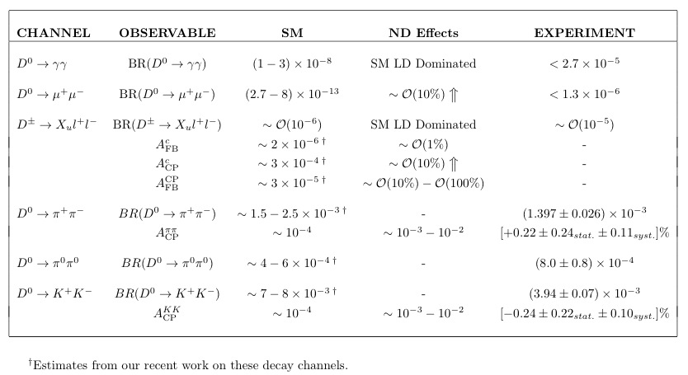
Charm Changing Neutral Currents

Slide 25



Two body problems.
Within the SM,
Indirect CP violation ~ 10⁻⁵.
Direct CP violation ~ 10⁻⁴.
CDF measurement is in excess of SM predictions.
The difference cited by LHCb is open to interpretation.

Slide 26
Direct CPV in LHT-like Models
Enhancement to direct CP asymmetry is O(10%).
NP cannot enhance direct CP asymmetry significantly.
NP can enhance indirect CP asymmetry to account for experimental values.
If CDF measurements are interpreted as NP effects, it is probably indirect CPV.

Slide 27
Three body problems.
Separation of weak and strong phase possible.
CP asymmetry does not depend on relative production of CP conjugate states.
Possible intervention of ND.
SM cannot generate direct CP violation.
2D Dalitz Plot analysis needs to be done.
CP asymmetry does not depend on relative production of CP conjugate states.
More data necessary but more information can be gleaned.

Slide 28





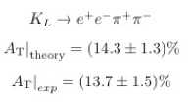
Four body problems.

Slide 29
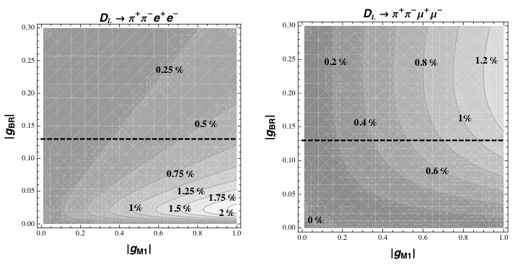
The Outcome.

Slide 30
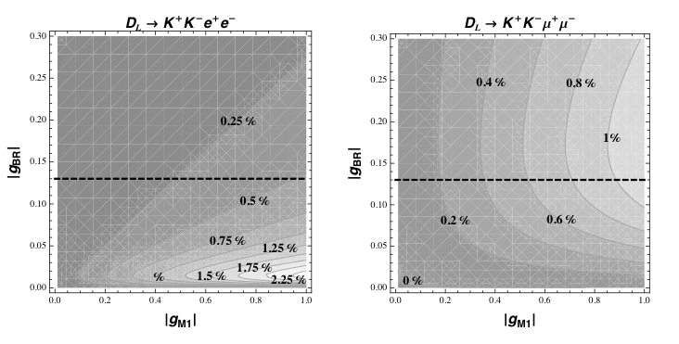
The Outcome.
Similar analysis for

Slide 31

Four body problems.
Time dependent CP analysis can be done.
T odd correlation can be probed.
Theoretically more challenging.
: CP violation from FSI, none from ND.
CA mode, CP violation possible within SM through interference with DCSD.
ND contribution possible.
T odd correlation can be probed.

Slide 32
TAPAS Reach.

Slide 33
The Bad News.
With current projections, data acquisition at TAPAS will start after PANDA.
At best TAPAS will barely make the PANDA benchmarks.
The best that TAPAS will have is tentative.
TAPAS will also have to compete with B factories.
Barely 10⁹ D pair productions barely justifies a full time open charm study
LHCb is a MONSTER.
The other monsters will team up with LHCb. (read: ATLAS, CMS, ALICE)
Manpower is necessary.
Disclaimer: I speak of open charm ONLY. If hurdles scared us, B Factories would not be a reality today!

Slide 34
As the gods began one world, and man another,
So the snakecharmer begins a snaky sphere
With moon-eye, mouth-pipe, He pipes. Pipes green. Pipes water.
Snakecharmer – Sylvia Plath

Slide 35

Of course, one can get lucky!!
( “… Best of Luck, you will need it!!”)*
Thank you…!!
* Ikaros would say…

Slide 36
Just in case they ask crazy questions…

Slide 37

Lessons from Charm
the Expected:
  To theorists, all models look promising (even the Standard Model).
  FCNCs and CP Violation provides a good testing ground for these models.
  SM has blessed (cursed) charm physics with tiny effects.
  Any self-respecting ND should come in with a bang!
the Unexpected:
  We do not live in a theorists’ world. (a.k.a. Nature does not care about us.)
  Experimental constraints come in all flavours.
  SM effects can be overcome but not overruled! “that’s life”*
the Gamble:
  Even theorists can be enterprising and innovative.
  “Leave no stone unturned” is a “good policy”!
the Real Analysis or how to find a Bookworm:
  Probing with specific models can lead to model independent results too. Generalization is the only weapon theorists have against Nature’s contempt for our favourite models!
* Ikaros would say…

Slide 38


LHT Particle Content
The T-even sector:
  SM gauge bosons
  SM fermions
  SM Higgs doublet
  A heavy partner to the top, T₊
The T-odd sector:
  The heavy gauge bosons
  A set of mirror fermions
  The scalar triplet:
  A T-parity partner to the heavy partner of the top, T₋
Model Parameters

Slide 39


Mass Assignments
The T-even sector:
  SM gauge bosons:
  SM fermions
  SM Higgs doublet
  A heavy partner to the top, T₊

Slide 40


Mass Assignments
The T-odd sector:
  The heavy gauge bosons
  A set of mirror fermions
  The scalar triplet
  A T-parity partner to the heavy partner of the top, T₋

Slide 41

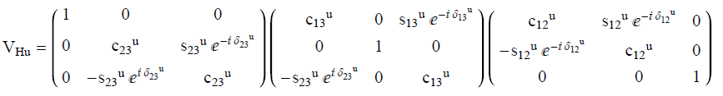
Non-Minimal Flavour Violation:
A side effect of LHT
In addition to V_{CKM} we also have two other unitary mixing matrices in the quark sector: V_{Hd} and V_{Hu}
V_{Hd} and V_{Hu} are not independent, hence, parametrizing one fixes the other.
A 3x3 unitary matrix can have 3 angles and 6 phases.
Unlike the CKM matrix, we can rotate away only three phases using the phase freedom of three mirror quarks.
V_{Hu} will have 3 angles and 3 CP violating phases.

Slide 42
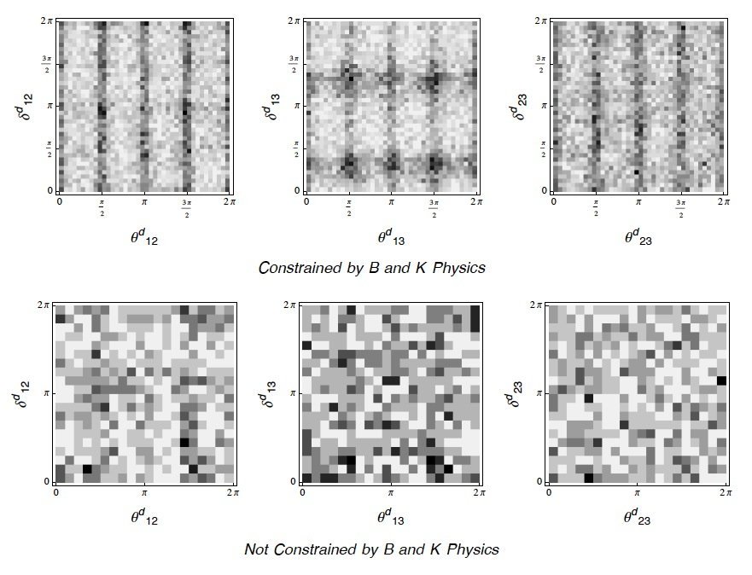
Experimental Constraints: The Big Sister
Histogram of the parameter space of the angles and phases in V_{Hd}

Slide 43
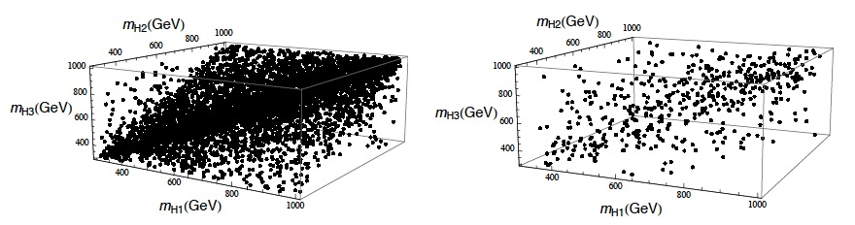
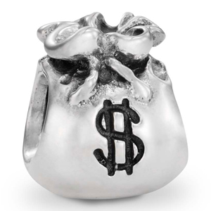
Mass Hierarchies in the Mirror Quark Sector
Parameter space of the mass of the mirror quarks.

Slide 44





Details of the Fermion Sector
N families of fermions. For SM N = 3
Isodoublets of a broken SU(2) X U(1).
The fermions are at most familywise mass degenerate.
Flavour eigenstates are misaligned from mass eigenstates.
Note on :
It does not need to be from the first family or the lightest.
It does not need to be the mass of any of the fermions.

Slide 45


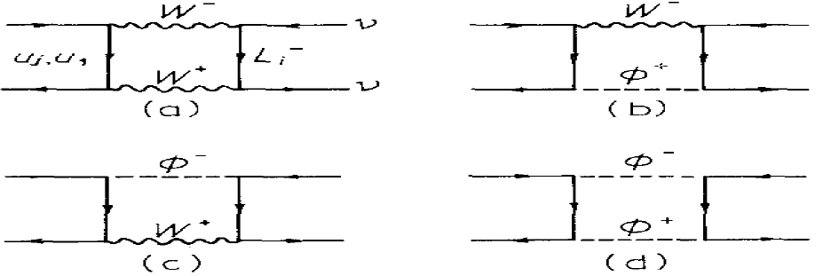
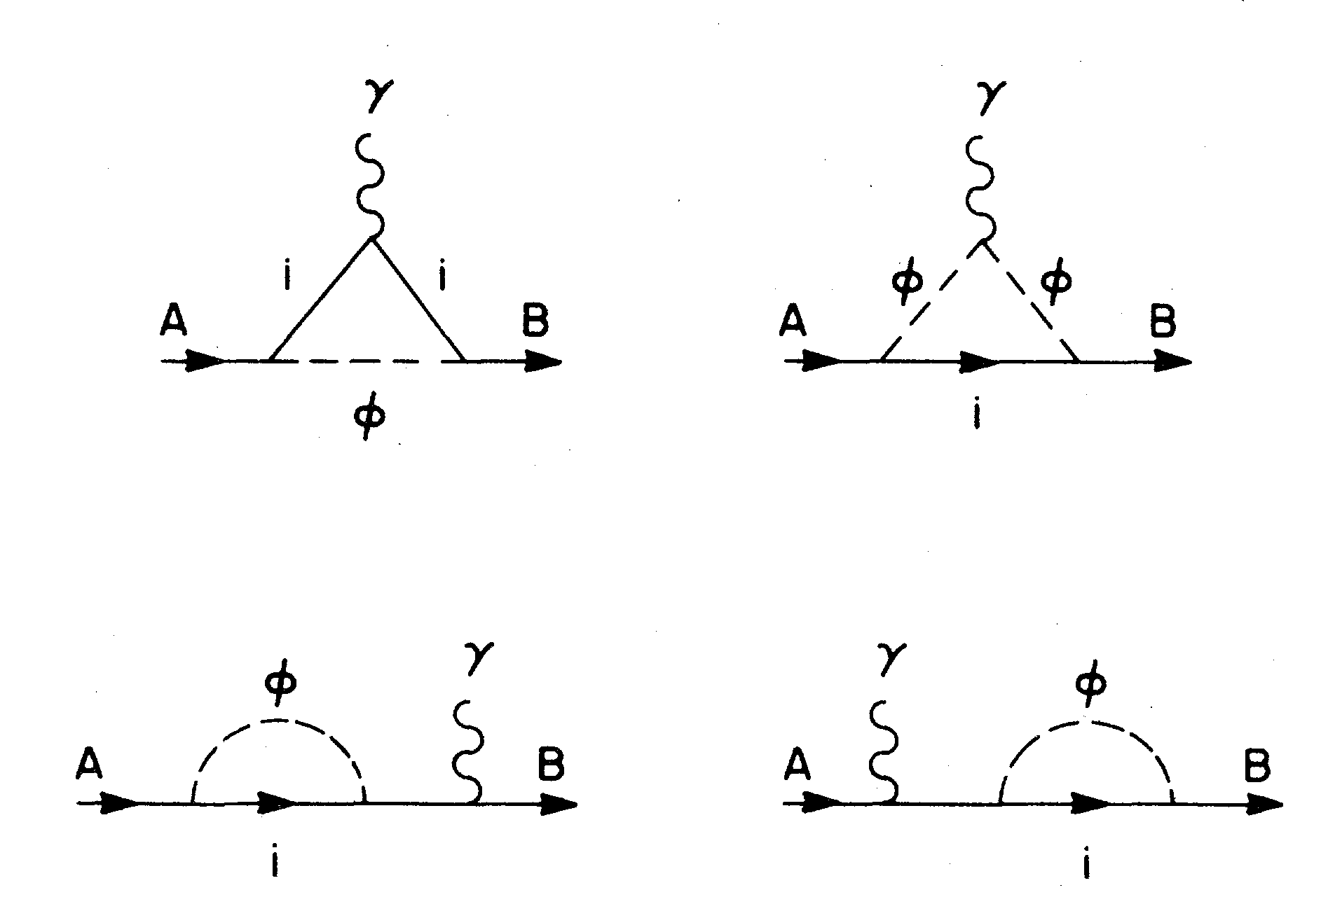

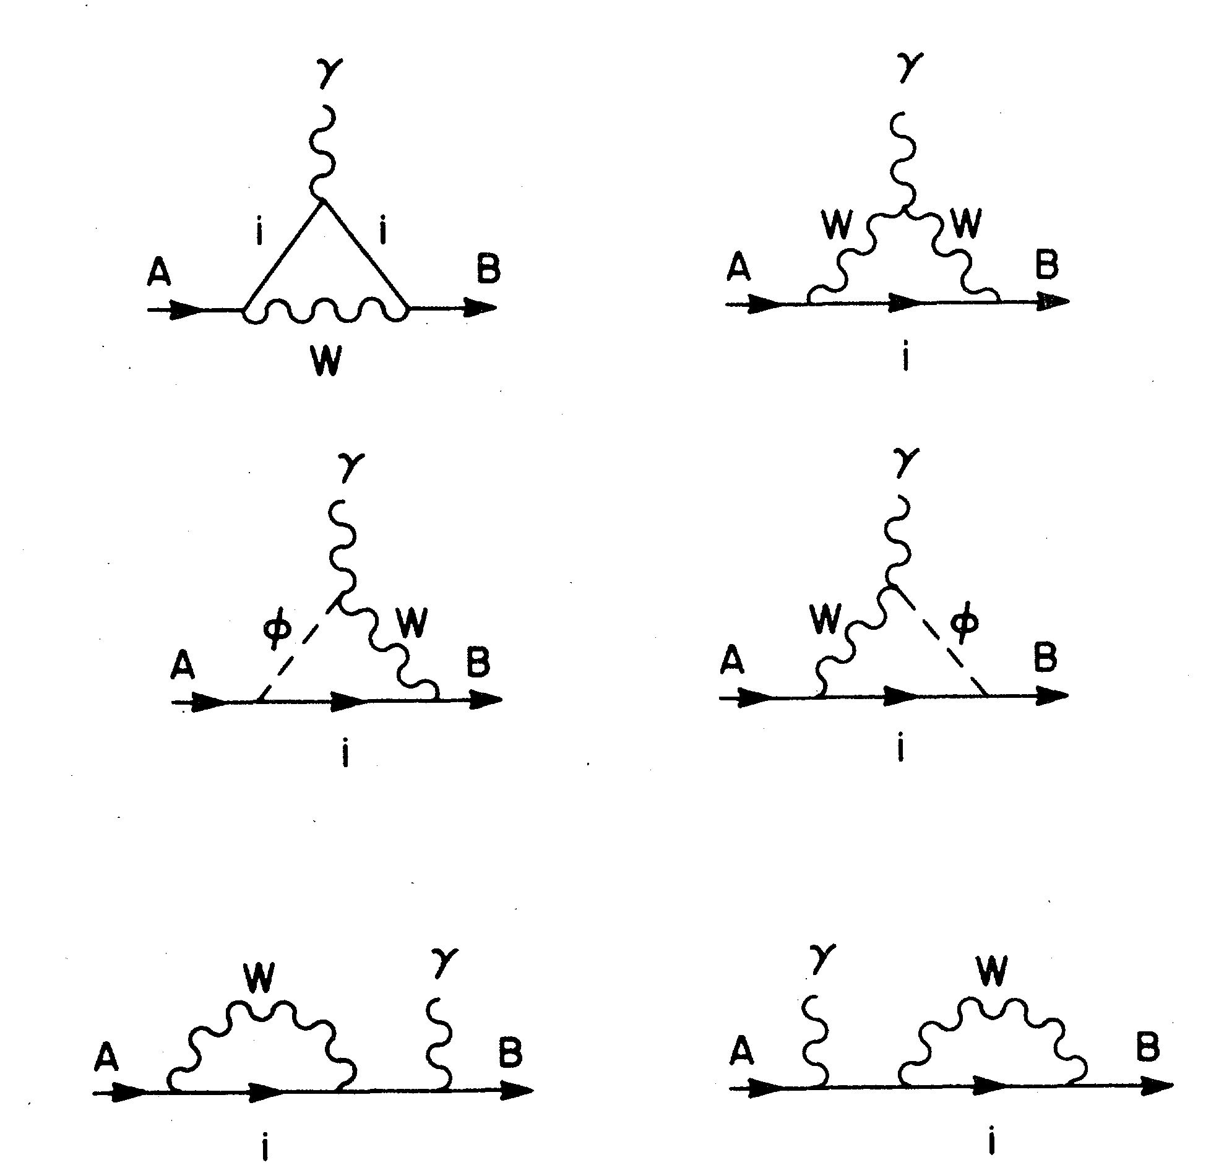
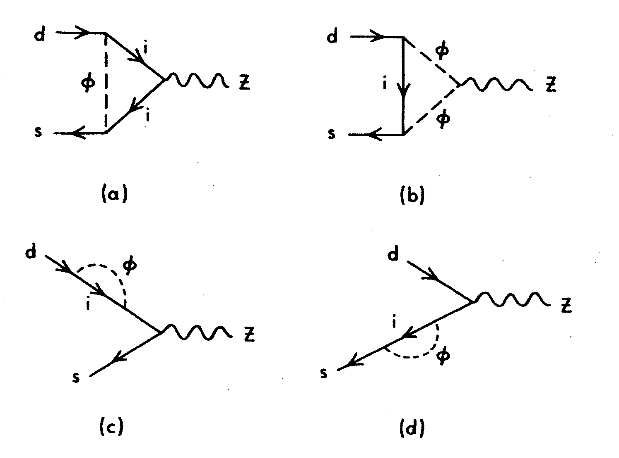

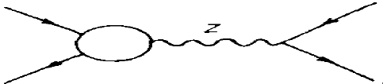

Boxes and Penguins
Box Diagrams
~ x
Photon Penguins
~ log(x)
Z Penguins
~ x log(x)

